Slide 1
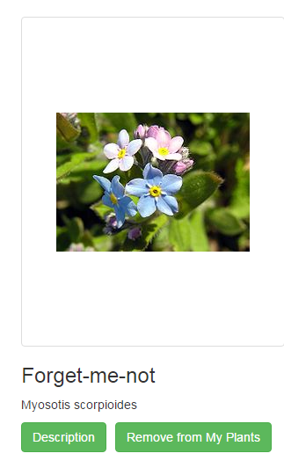
Plant Sim
Plant men:
Andy, Artem, Jae, Mike, Alex

Slide 2
Product Vision
-An application that uses a database to track and record the simulated growth of a plant that’s based on a real one.
-The database tracks the current weather location, the optimal growth of the plant, and the actual growth of the plant
-To forward growth the end user needs to water the plant based on the type, and should consider daily weather patterns.
-The goal is to teach the end user how to care for a certain real-life plant, while also taking into consideration the location, which is more of a dynamic factor.

Slide 3
Execution
- The app was made with a MySQL database, PHP, and JavaScript.
- Files were exchanged with the group through github
- Communitiation was done with im, weekly meetings, and sprints
- A prototype was completed by the end of the 4th sprint.
- Source files were shared through Github.
- MySQL database was used, which holds the location data, plant growth goals, and writes the current state of the plant growth

Slide 4
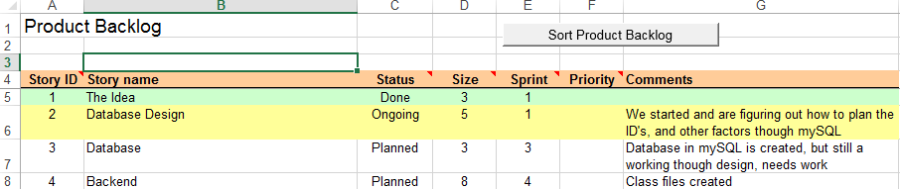
Organization
The group worked in sprints, and utilized agile methods we learned. Sample product backlog planning.
Here’s an example of our sprint backlog

Slide 5
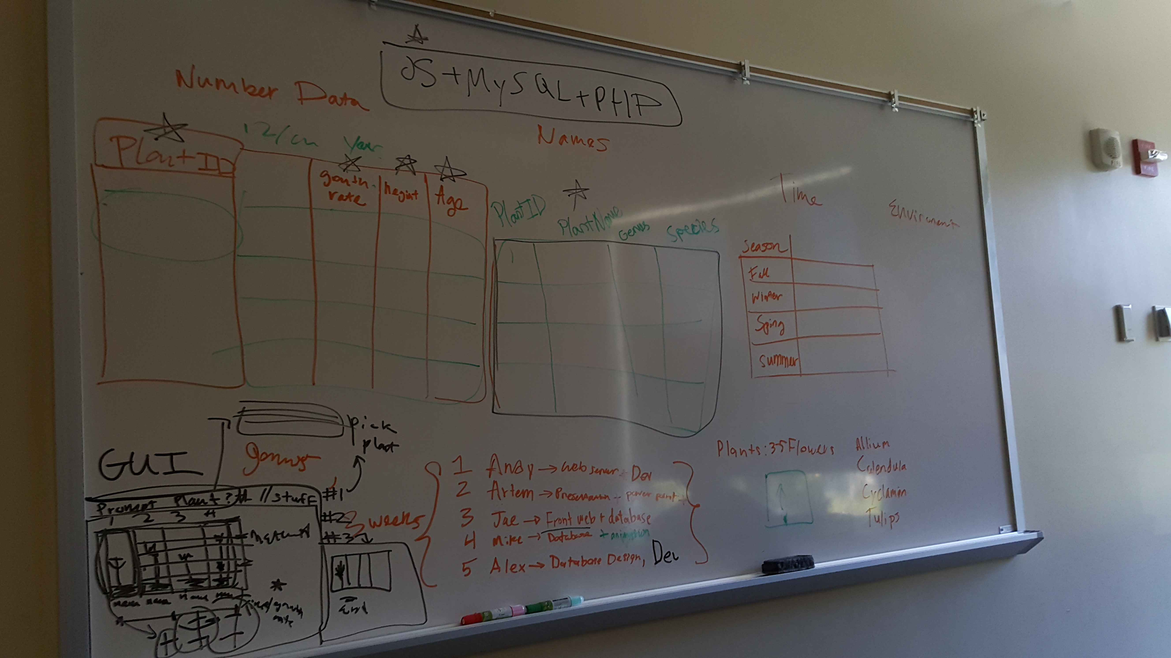
Meetings & Sprints

Slide 6
Problems & Solutions
One of the difficult things about this project that came up in the sprints was the integration between backend code, database and GUI.
Animations for our simulation. We decided to just drop the simulation altogether.
Since everyone knew Java we started with that, but had difficulty finding a good way to integrate it efficiently in the web environment. During our incremental development through sprints, we switch to PHP and JavaScript for something much better, which produced better results and productivity in the long run.
Bugs in the website were squashed by Andy and Jae

Slide 7
Resulting Prototype
- A plant database repository in SQL, dropped simulation
- Descriptions, values, and images are synced with Wikipedia's data and our plant matching algorithm
- Functional buttons, inputs, and ways to modify data
- Scientific plant names, and other methods of data fetching from the wiki
- A plant repository of saved user values
- A login & registry along with a functional Website
- Fixed bugs with clean backend for future development and flexible code

